Slide 1
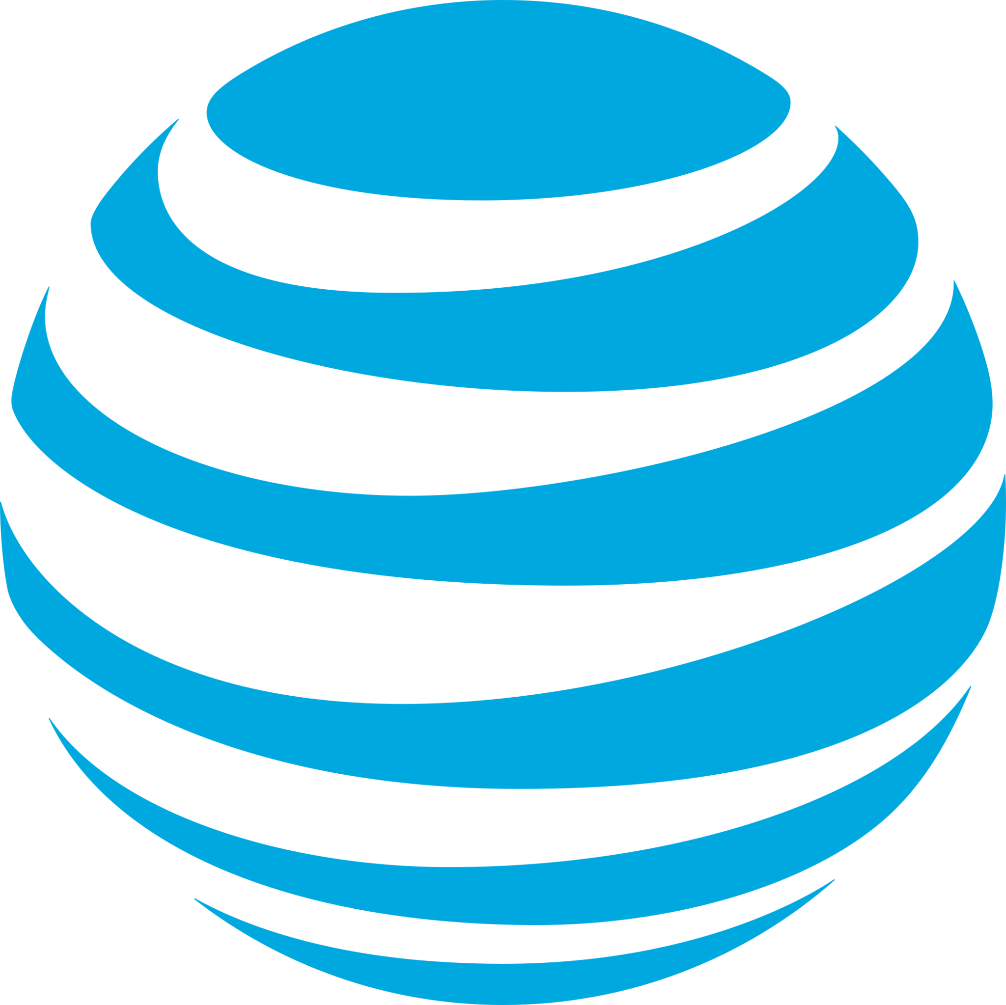
An Assessment of AT&T’s Information Security Policies and Enforcement
Michael Garcia
Daniel Garza Professor:
Abdul Alqarni Dr. Gonzalo D. Parra

Slide 2
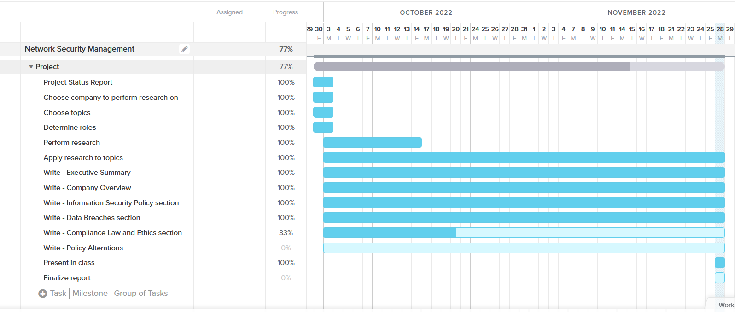
Gantt Chart

Slide 3
Company Overview
Purpose - “Connecting people to greater possibility - with expertise, simplicity, and inspiration”
Started in 1885 as Bell Telephone Company, became AT&T in 1985
Senior Executive Vice President, Chief Compliance Officer - David S. Huntley
Chief Technology Officer - Jeremy Legg

Slide 4
Information Security Policy
Chief Security Office - handles creation and enforcement of security policies/standards
AT&T Security Policy and Requirements (ASPR)
Takes inspiration from ISO 27001
Applies to all employees and contractors
Supplier Information Security Requirements - Must apply to suppliers

Slide 5
Information Security Policy (continued)
Penetration Testing
Regular automated scanning - commercial and proprietary tools
Manual testing performed only by internal personnel
Global Technology Operations Center
24/7 Network Monitoring
almost real-time data correlation
Bug Bounties
Utilizes HackerOne platform
Exclusively public facing environments

Slide 6


Slide 7
Data Breaches
Circa 2017, AT&T documented an upward trend in third parties notifying companies of breaches rather than internal IT
In a survey of who detects a company’s breach first:
50% employees
25% law enforcement
21% customers
19% service providers
In 2022, AT&T identifies ransomware as a major threat regarding data breaches in Cybersecurity Insights Report
People survey results show ransomware as the highest concern overall
AT&T’s data breaches can be attributed to data mishandling and operational vulnerabilities

Slide 8
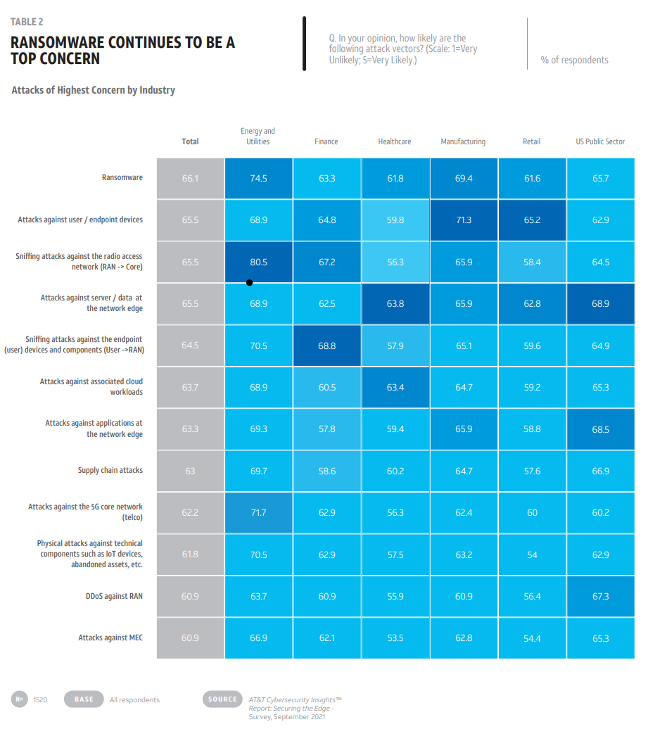

Slide 9
Data Breaches (continued)
Year | Lost Data | Attack Vector | Threat Actors | Resolution
2010 | 114,000 email addresses associated with customer SIM ICC-ID numbers on iPads. Emails included Michael Bloomberg, Harvey Weinstein, and the CEOs of NY Times, Time Inc., and Dow Jones. | PHP script used to automate entering semi-random SIM ICC-ID numbers into HTTP requests, yielding email addresses when valid. | G. Security (ran exploit, then reported it to a third-party) | AT&T shut down the script behind the feature and informed affected customers whose information may have been obtained.
2013 & 2014 (discovered 2015) | 290,000 customers’ names and full or partial social security numbers. | Employees accessed customer accounts without proper authorization to assist with unlocking phones, but process was used to traffic stolen phones. | Unknown third-parties (employee data mishandling) | AT&T sent out a breach notification to affected customers, offered credit monitoring. Paid $25 million civil penalty from FCC. Terminated select vendor sites.
2022 (unconfirmed) | 70 million customer records in a database. | Unknown (data appeared for sale online on the dark web, days after confirmed stolen data from T-Mobile was sold). | ShinyHunters (responsible for 2020 Microsoft Developer GitHub hack) | AT&T denied accountability, pushed blame to another unknown company.

Slide 10
Compliance - Law & Ethics
AT&T Security Policy and Requirements (ASPR) complies with the following:
NIST Cybersecurity Framework and 800-53
European Union’s General Data Protection Regulation (GDPR)
Criminal Justice Information Services (CJIS) Security Policy
California Consumer Privacy Act (CCPA)
Annual audits
Payment Card Industry (PCI) Data Security Standard
Information Security Standard (ISO/IEC 27001)
Sarbanes-Oxley Act (SOX)
SSAE 18/ISAE 3402 (SOC)
Quality Management Standard (ISO 9001)

Slide 11
Policy Alterations
After the 2015 breach, the FCC ordered AT&T to implement a compliance plan
Ensures appropriate processes and procedures are incorporated into business practices to prevent future data breaches for customers
AT&T was required to improve its privacy and data security practices
Informed to appoint a privacy-certified senior compliance manager, conduct a privacy risk assessment, implement an information security program, prepare a compliance manual, and regularly train employees on the company’s privacy policies and applicable privacy legal authorities.

Slide 12
Resources
AT&T Bug Bounty - Welcome. (n.d.). Retrieved November 28, 2022, from https://bugbounty.att.com/
AT&T Cyber Aware: Fraud Prevention & Cybersecurity Program. AT&T Cyber Aware | Fraud Prevention & Cybersecurity Program. (2019, March 11). Retrieved November 28, 2022, from https://about.att.com/pages/cyberaware
AT&T Cybersecurity insights report 2022. AT&T Business. (n.d.). Retrieved November 28, 2022, from https://www.business.att.com/categories/cybersecurity-insights-report.html
AT&T Issue Brief: Network & Data Security: AT&T Social Responsibility. AT&T News, Wireless and Network Information. (n.d.). Retrieved November 28, 2022, from https://about.att.com/csr/home/reporting/issue-brief/network-data-security.html
Coldewey, D. (2010, June 10). AT&T Security Breach Leaks Thousands of iPad owners' emails (but luckily, little else). TechCrunch. Retrieved November 28, 2022, from https://techcrunch.com/2010/06/09/att-security-breach-leaks-thousands-of-ipad-owners-emails-but-luckily-nothing-more/
Cooper, C. (2017, August 17). How cyber attacks & data breaches are discovered. AT&T Business. Retrieved November 28, 2022, from https://www.business.att.com/learn/research-reports/how-data-breaches-are-discovered.html

Slide 13
Resources (continued)
History of AT&T Brands: AT&T Intellectual Property. History of AT&T Brands | AT&T. (2016, October 5). Retrieved November 28, 2022, from https://about.att.com/innovation/ip/brands/history
Holden, A. (2022, August 11). It might be our data, but it's not our breach. Krebs on Security. Retrieved November 28, 2022, from https://krebsonsecurity.com/2022/08/it-might-be-our-data-but-its-not-our-breach/
Lapienyte, J. (2022, April 12). AT&T database of 70 million users sold on Hacker Forum - Cybernews. Cybernews. Retrieved November 28, 2022, from https://cybernews.com/news/att-database-of-70-million-users-sold-on-hacker-forum/
Moore, M. (2020, May 8). Microsoft github account reportedly hit in huge cyberattack. TechRadar. Retrieved November 28, 2022, from https://www.techradar.com/news/microsoft-github-account-reportedly-hit-in-huge-cyberattack
Nayak, M. (2015, April 8). U.S. FCC imposes $25 million fine on AT&T over Customer Data Breach. Reuters. Retrieved November 28, 2022, from https://www.reuters.com/article/us-at-t-settlement-dataprotection/u-s-fcc-imposes-25-million-fine-on-att-over-customer-data-breach-idUSKBN0MZ1XX20150408
Rosenfeld, E. (2015, April 8). AT&T data breaches revealed: 280K US customers exposed. CNBC. Retrieved November 28, 2022, from https://www.cnbc.com/2015/04/08/att-data-breaches-revealed-280k-us-customers-exposed.html

Slide 14
Resources (continued)
Tate, R. (2010, June 9). Apple's worst security breach: 114,000 iPad owners exposed. Gawker. Retrieved November 28, 2022, from https://www.gawker.com/5559346/apples-worst-security-breach-114000-ipad-owners-exposed
AT&T to pay $25m to settle investigation into three data breaches. Federal Communications Commission. (2018, October 10). Retrieved November 28, 2022, from https://www.fcc.gov/document/att-pay-25m-settle-investigation-three-data-breaches

